Slide 1


Reflux after Sleeve Gastrectomy and Hiatus Hernia Repair; a Study of Suture and Mesh repairs.
Methods and Materials: 279 patients underwent (LSG) with either suture or mesh repair of concomitant hiatus hernia between (2012 to 2016) at one institution. Surgical technique was consistent with both surgeons. Patients demographics, operative details, pre-operative physical measurements and symptoms were collected. Pre- and post-operative reflux was assessed by pharmacological parameters and patient self-reporting scale. Follow up Total Body Weight Loss (TBWL), BMI and Excess Weight Loss (EWL) % were examined and stratified accordingly. Comparison analysis between (LSG- suture cruroplasty) and (LSG- mesh repair) patients was conducted.
Alhayo ST ^{2,3}, Brancatisano R¹, Devadas M ^{1,2,3}
¹ CircleOfCare, NSW Australia
² Department of Surgery, Nepean Hospital NSW
³ Nepean Clinical School, The Sydney University
Background: Reflux remains a prevalent post-operative consideration associated with surgical intervention for weight loss. There are controversies whether simultaneous hiatoplasty is protective against reflux. No studies have further stratified the effects of different repairs yet.
Objectives: Evaluate reflux outcomes of LSG with either suture or mesh hiatoplasty.

Slide 2
Reflux after Sleeve Gastrectomy and Hiatus Hernia Repair; a Non-Randomised Prospective Study of Suture and Mesh repairs.
Results: 71 and 67 patients had LSG with suture and mesh repair respectively with>6 months follow up. 83.4% were females. Preoperatively, mean BMI was 42.75. Postoperative BMI, TBWL%, EWL% for both groups were similar and of no statistical significance (Graph 1). Though preoperative reflux was more prevalent in mesh group (Graph 1,2,3). However, it was statistically less prevalent post-operatively in mesh group than suture group (p<0.001).
Graph 1
Graph 2

Slide 3
Reflux after Sleeve Gastrectomy and Hiatus Hernia Repair; a Non-Randomised Prospective Study of Suture and Mesh repairs.
Conclusion: Mesh repair of concomitant hiatus hernia in patients undergone LSG revealed significant benefit in management of post-operative reflux over suture cruroplasty only. Further study is to follow comparing results to LSG only.
Graph 3
Graph 4

Slide 4
Post Sleeve gastrectomy reflux symptoms
Ongoing prospective research is being conducted to investigate the symptoms of all patients underwent laparoscopic sleeve gastrectomy.
Of the 1500 patients identified to have undergone sleeve gastrectomy at Circle of Care between 2011 and 2016, 568 patients have -to-this-date- responded to the questionnaire.

Slide 5
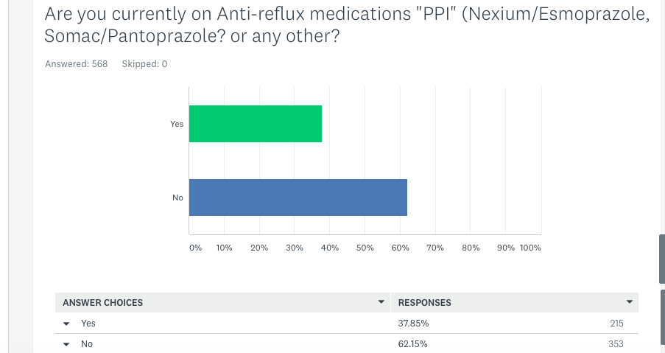
COC

Slide 6
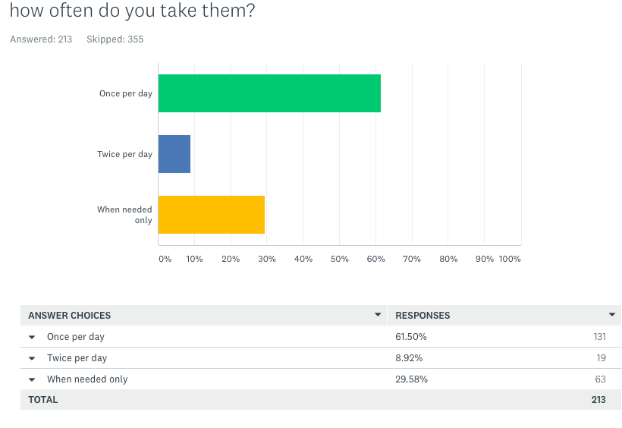

Slide 7
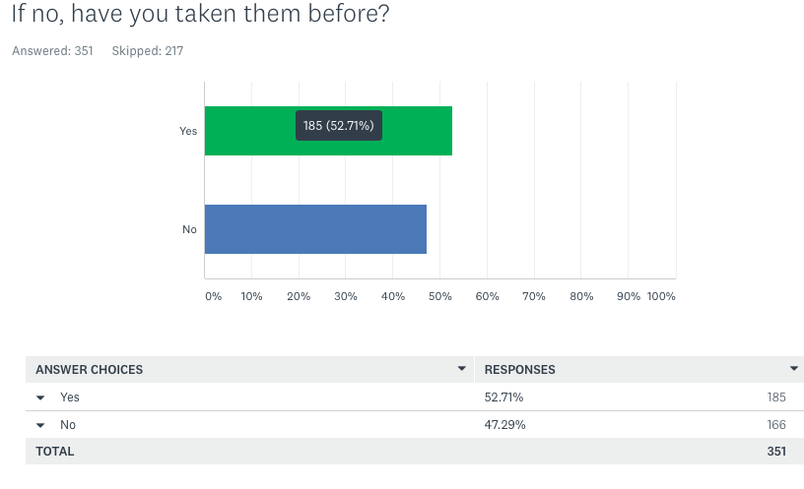

Slide 8
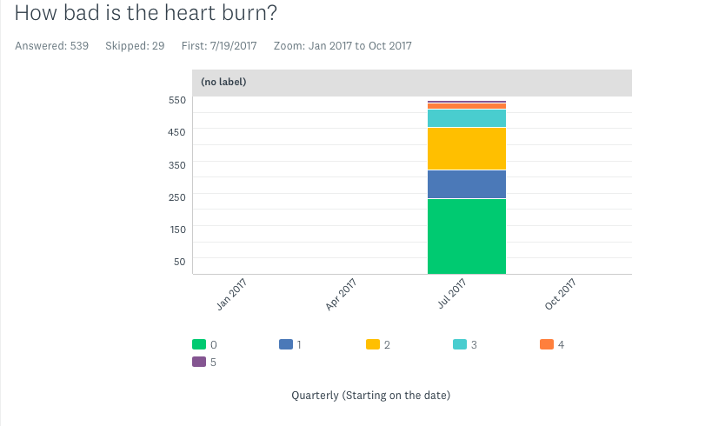


Slide 9
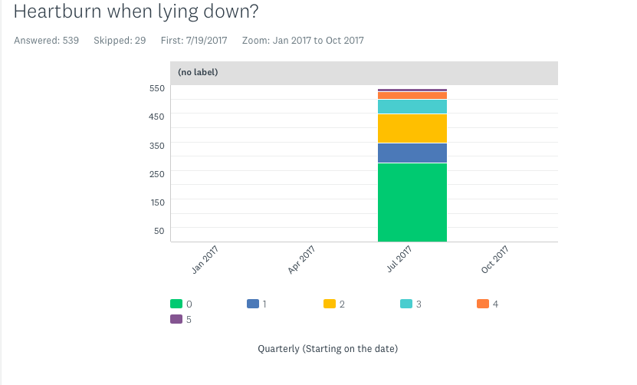


Slide 10
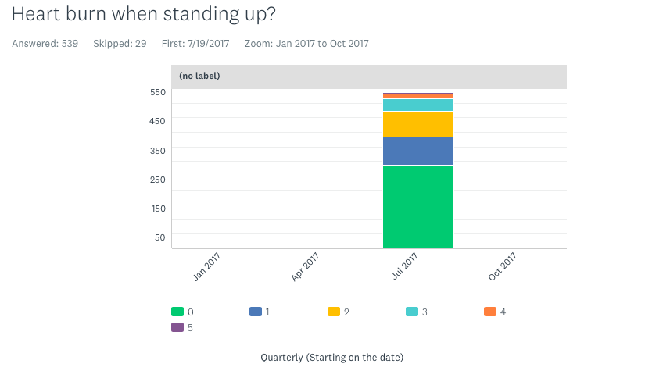


Slide 11
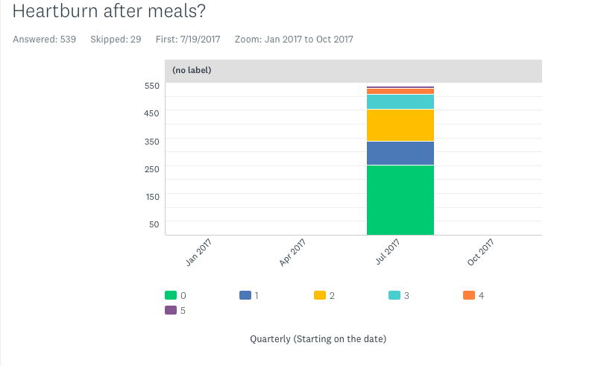


Slide 12
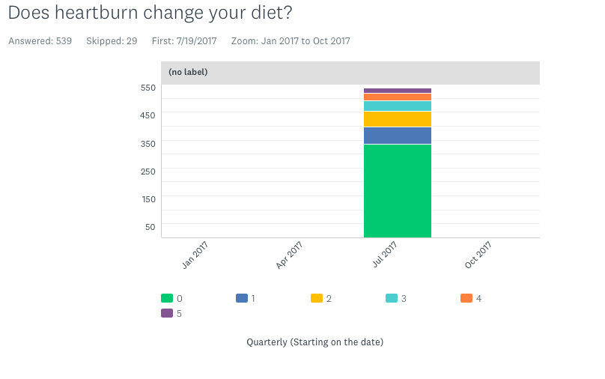


Slide 13
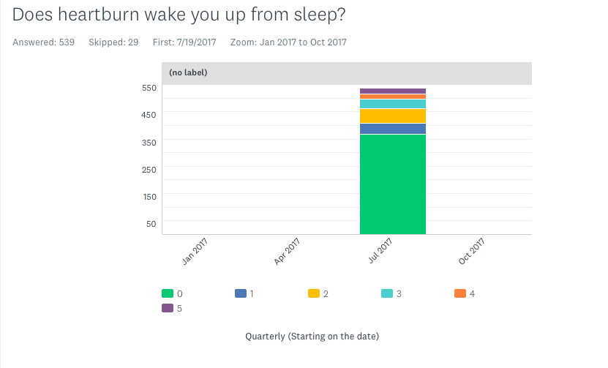


Slide 14
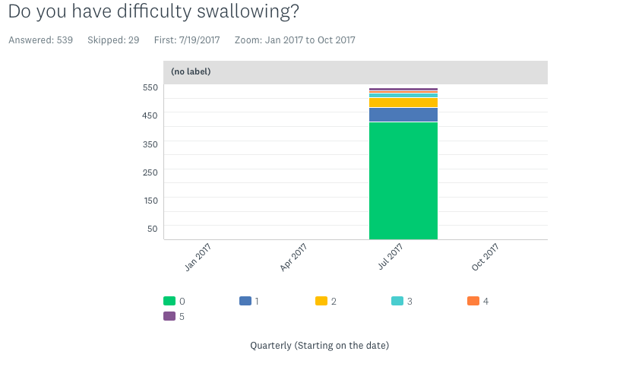


Slide 15
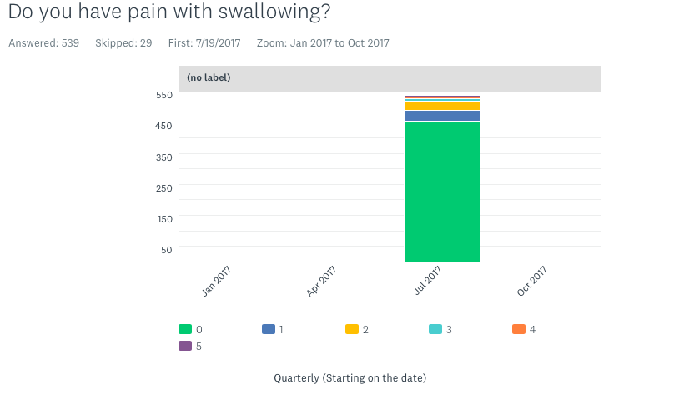


Slide 16
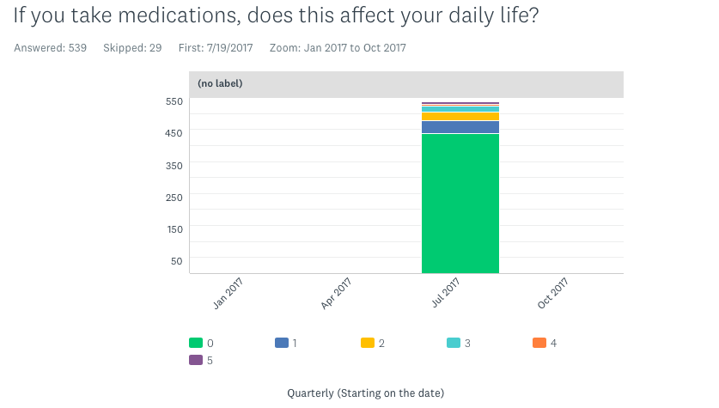


Slide 17
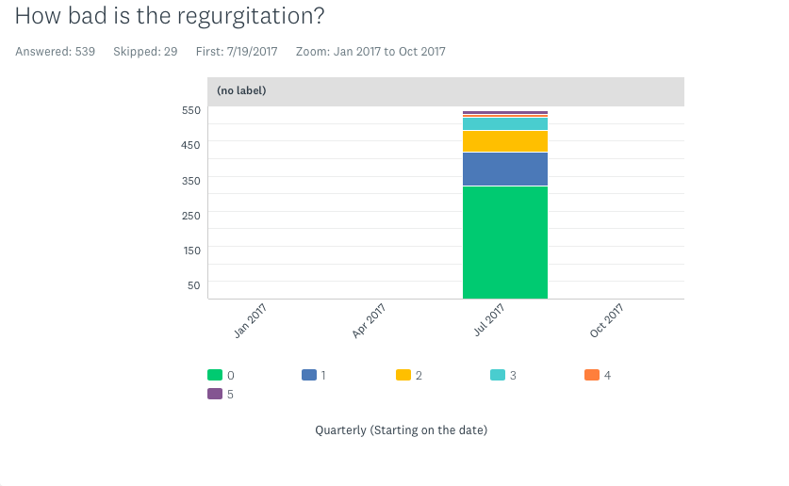


Slide 18
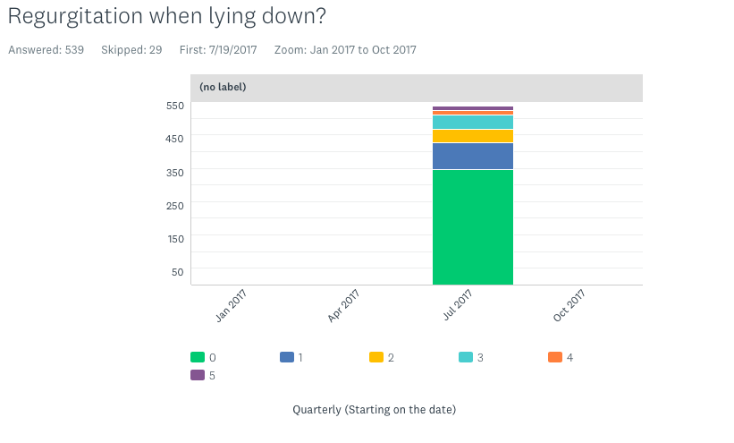


Slide 19
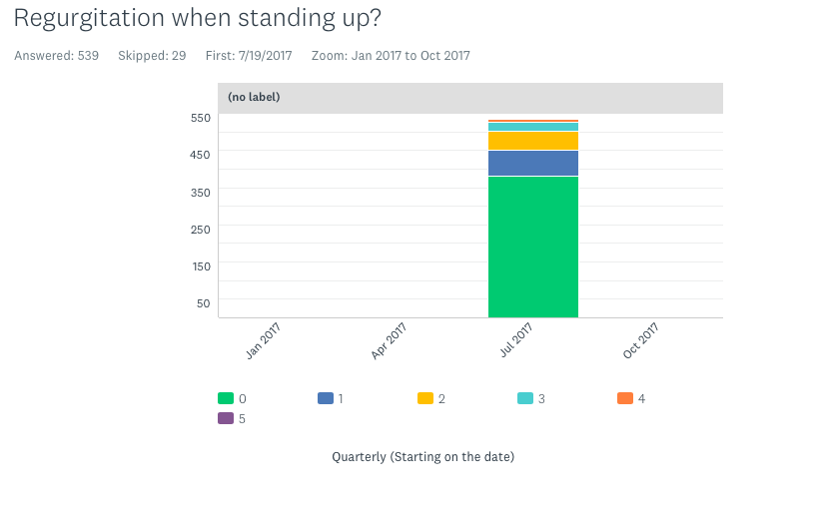


Slide 20
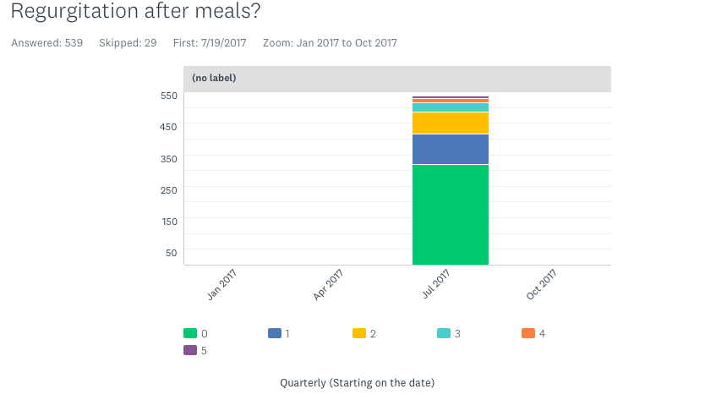


Slide 21
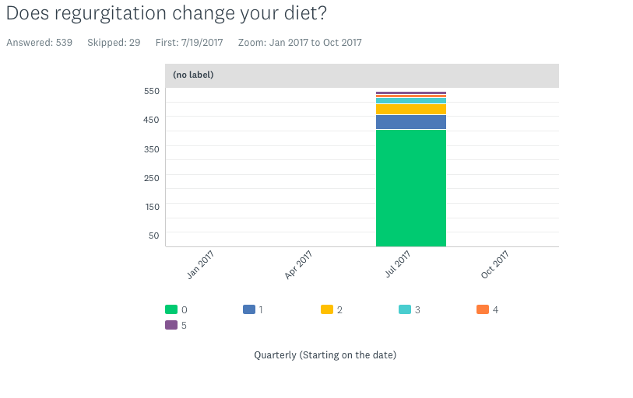


Slide 22
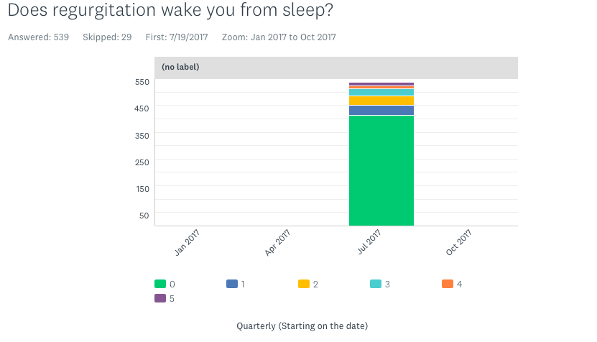


Slide 23
